Slide 1
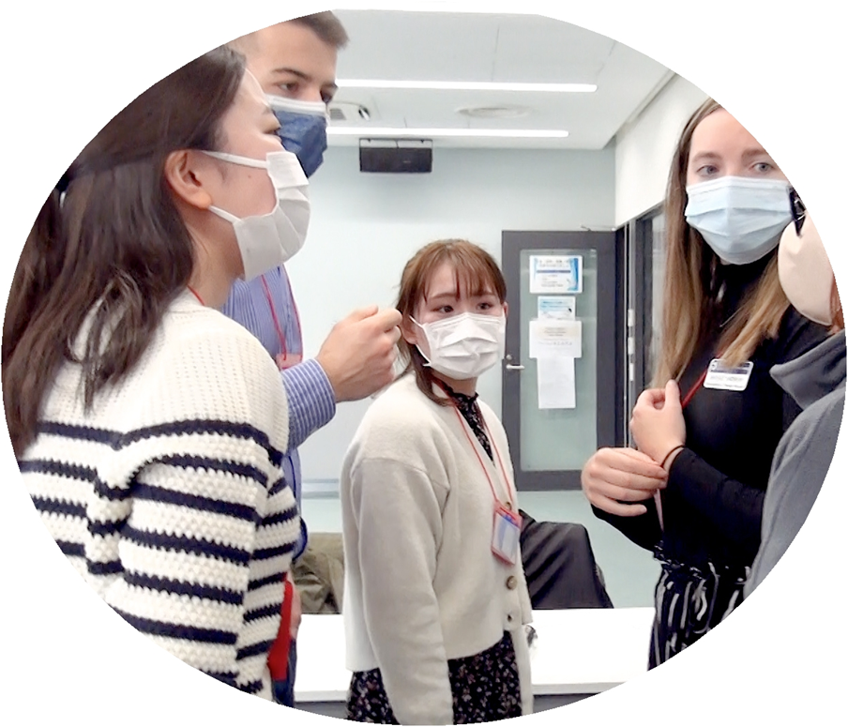
Kitasato University
invites overseas students to
Cross-Cultural Interdisciplinary Case Study
in Japan
March 10 to March 15, 2024
Aim
This case study lets the students exchange their most recent and evidence based skill and knowledge in health care, as well as sharing social values from an ethical stand point across countries.
Outline
March 9
March 10
March 11-14
March 15
March 16
Transfer to the hotel near Kitasato University
*Some students will leave their country on March 8 (Fri)
Orientation and icebreaker activity
Cross-cultural interdisciplinary case study (discussion & presentation)
Cultural exchange/Sightseeing
Departure
Participants
FH Campus Wien (Austria), Charles University in Prague (Czech Republic), University of Marburg (Germany), Gabriele d’Annunzio University (Italy), University of Medical Technology, Yangon (Myanmar), Inland Norway University of Applied Sciences (Norway), National Cheng Kung University (Taiwan), Ulster University (U.K), Thomas Jefferson University (U.S.), University of Kentucky (U.S.), University of California, Irvine (U.S.) and Kitasato University (secretariat of this program).

