Slide 1
Submitting your Paper
Submission to a Karger Journal

Slide 2

Steps to follow:
Log in – as an Author
See progress – Author Dashboard
Guidelines – Submission guidelines
Authors – And Co-authors
Details – How to enter Funding and OA Agreement Information
Keywords – Add custom keywords
Documents – Choose the files
Reviewers
Letter – Cover letter and accompanying information
Send – Submit your manuscript

Slide 3
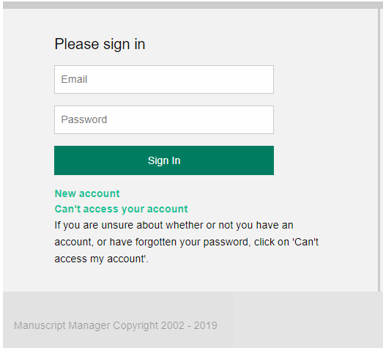
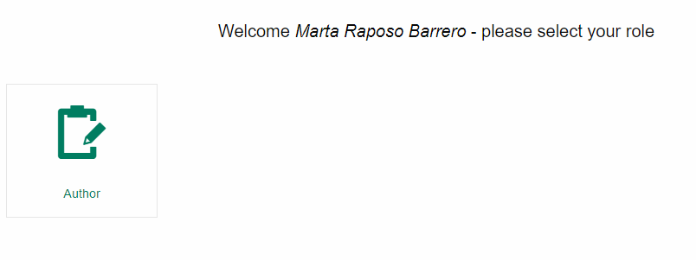
Log in – as an Author
If you have an account:
Log in using your Email and Password
Click on “Author”
If you do not have an account:
How to create a new account
https://manuscriptmanager.nickelled.com/author-online-submission?ngroup=link
1
1
2
3
3
2

Slide 4
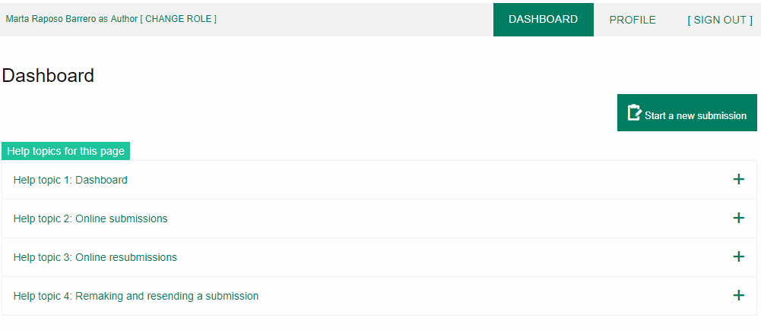
See progress – Author Dashboard
Click on:
“Start a new Submission”

Slide 5
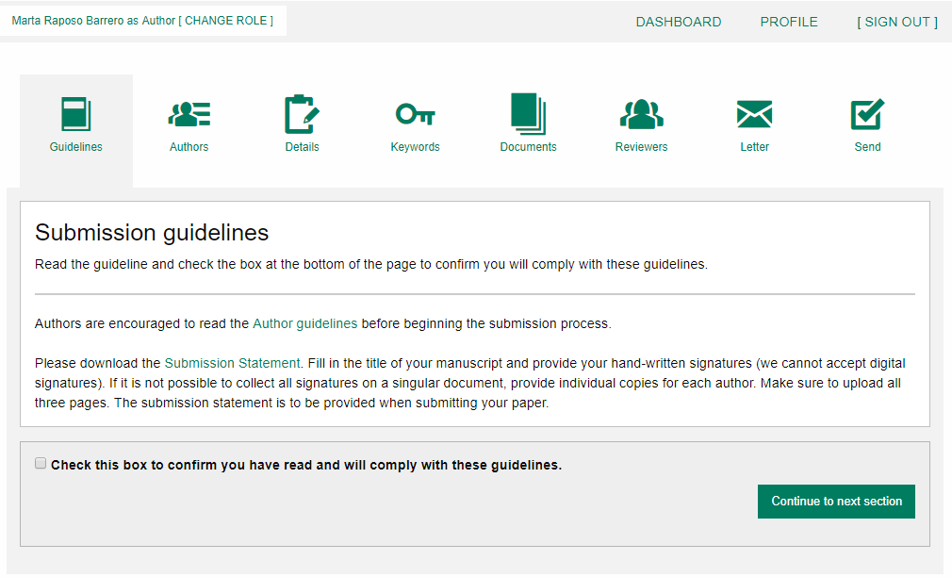
Guidelines – Submission guidelines
1
2
Confirm you have read the Guidelines pertinent to the Journal to which you are submitting.
Click on “Continue to next section”
1
2

Slide 6
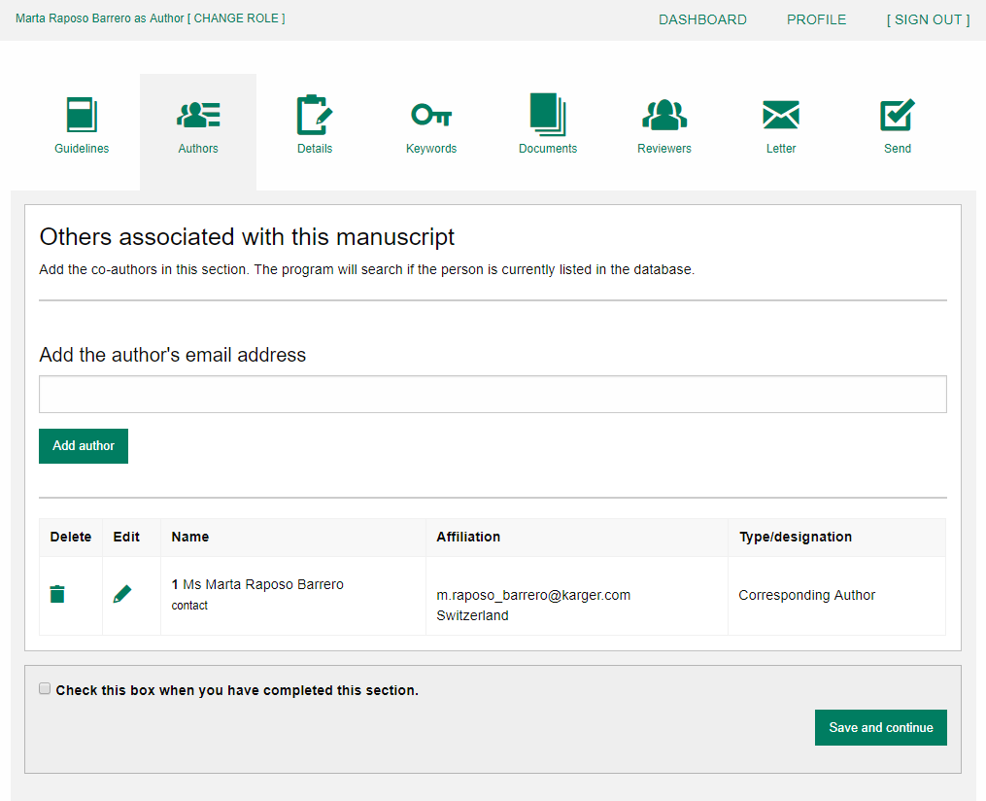
Authors – And Co-authors
Add the co-authors one-at-a-time by first entering the co-authors’ email addresses:
If the co-author is already in the database, he/she will appear in the list
If the co-author is not already the database, the submitting author must
add the co-author’s
information
Click on “Add Author”
Check the box when completed
Click on “Save and Continue”
1
1
a.lorenz@karger.com
2
2
3
4
4
3

Slide 7
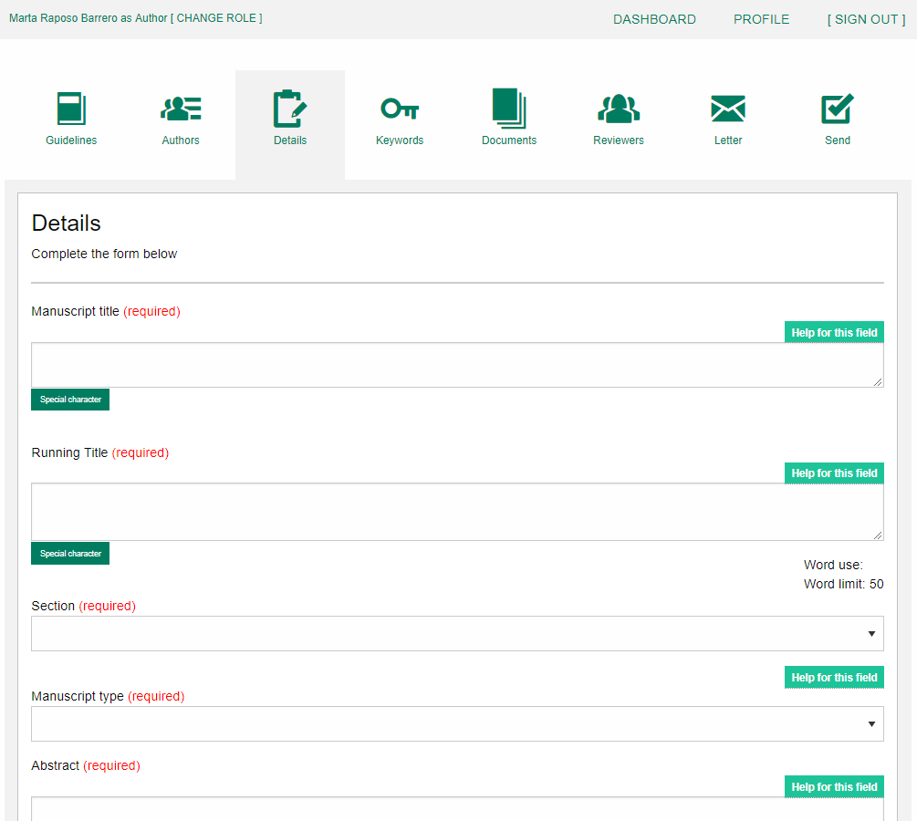
Details – How to enter Manuscript Information
Select the appropriate Section of the journal for your manuscript:
Open the drop-down menu and select the section most suited to your submission. This may well be None.
Make sure to select the right Manuscript type by opening the drop-down menu
Please check the journal’s Guidelines for more information
1
2
1
2

Slide 8
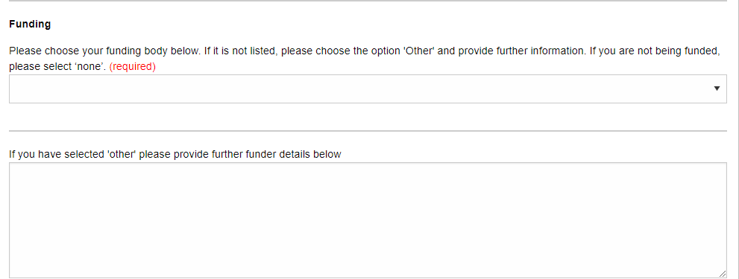
Details – Enter funding information
You will be asked to select your funding body or state None here
If you choose the option ‘other’ please provide further information in this field.

Slide 9
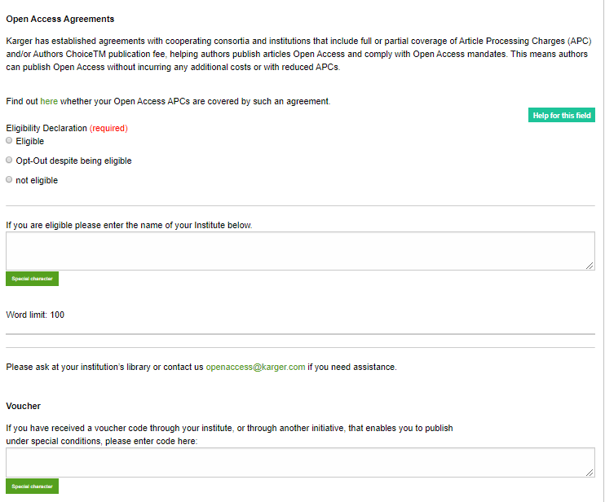
Details – Open Access Agreements
You will be asked to specify whether your institute has an Open Access Agreement with Karger. All entries will be checked and verified upon acceptance of the paper
For information regarding the Open Access Agreements you can follow the link in the submission field. See print screen on next slide
If the agreement comes with a specific voucher, please provide details here
1
1
2
2

Slide 10
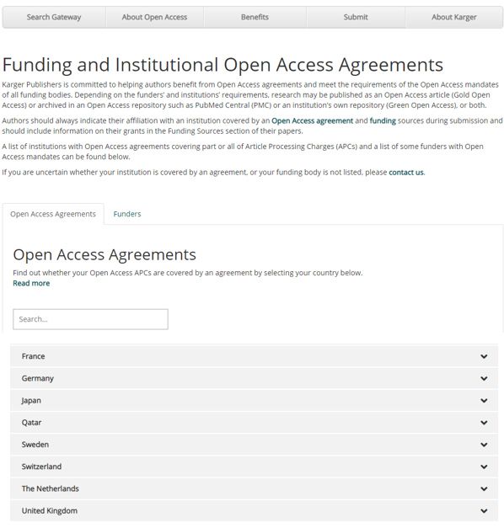
Details on Open Access Agreements on our website

Slide 11
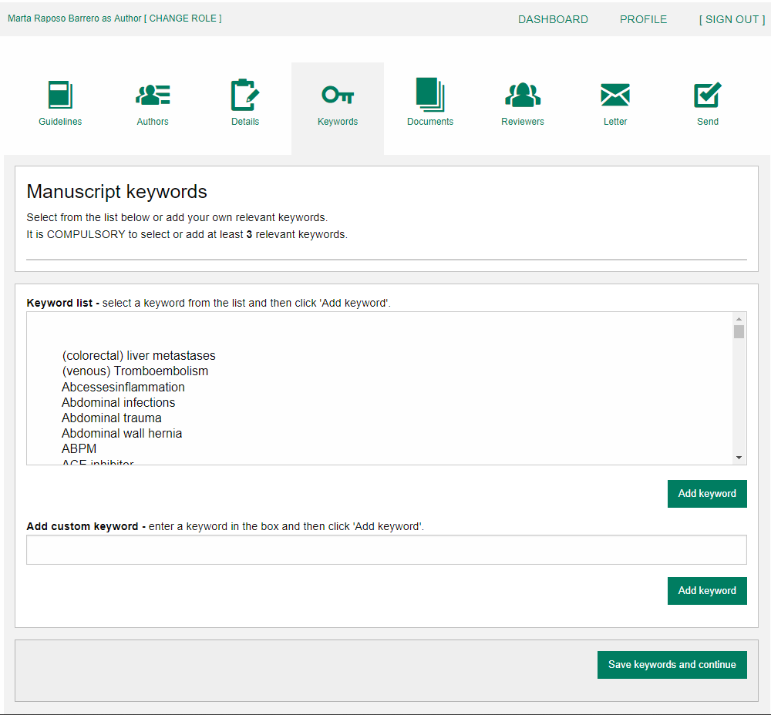
Keywords – Add custom keywords
Add the custom Keywords pertinent to your manuscript one-at-a-time
You can add your own or select relevant ones from the list
Click on “Save keywords and Continue”

Slide 12
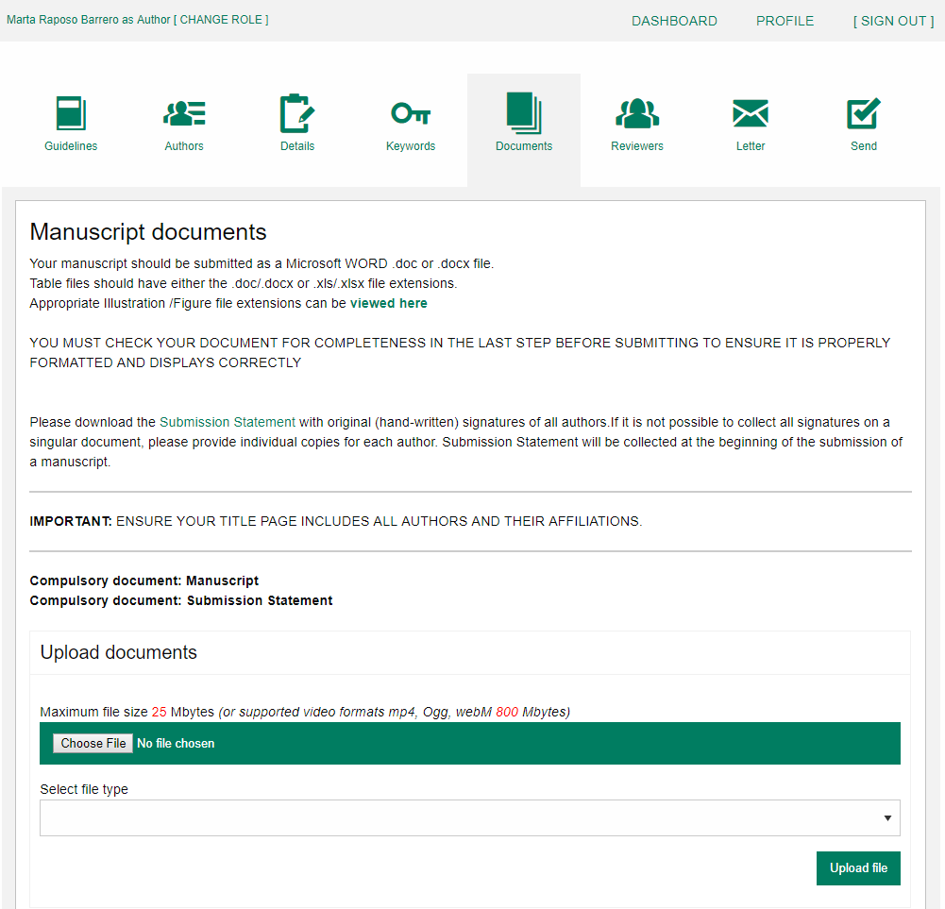
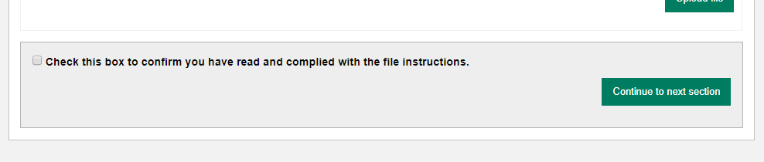
Documents – Choose the files
Upload one-at-a-time your manuscript files. Be sure to include the compulsory documents
- Select for each file the corresponding file type.
After choosing each file, click on “Upload File”
Check the box when completing the section
Click on “Continue to next section”
1
2
3
1
4
2
3
4

Slide 13
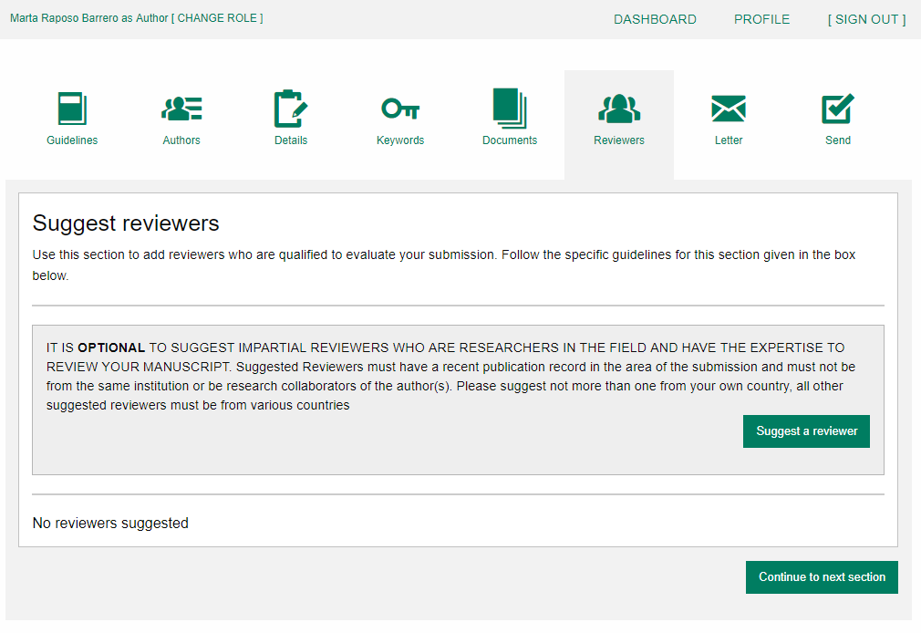
Reviewers
Suggested Reviewers are often requested as a standard by the journal’s portal.
Click on “Continue to next section”

Slide 14
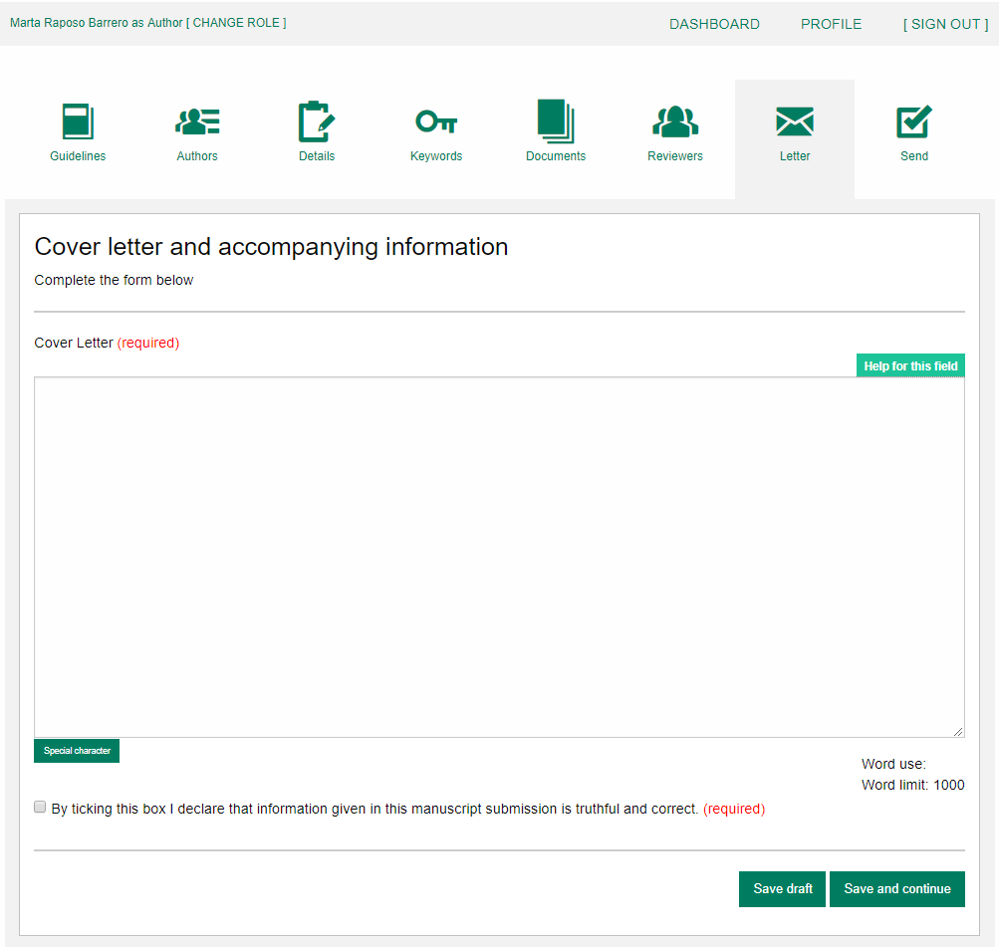
Letter
Complete the form by writing the Cover Letter
Check the box when completing the section
Click on “Continue to next section”
1
2
1
3
2
3

Slide 15
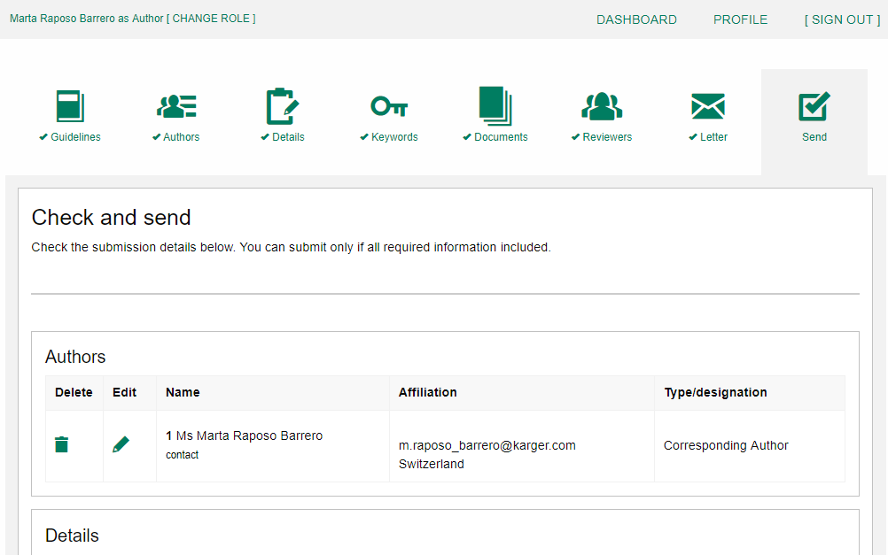
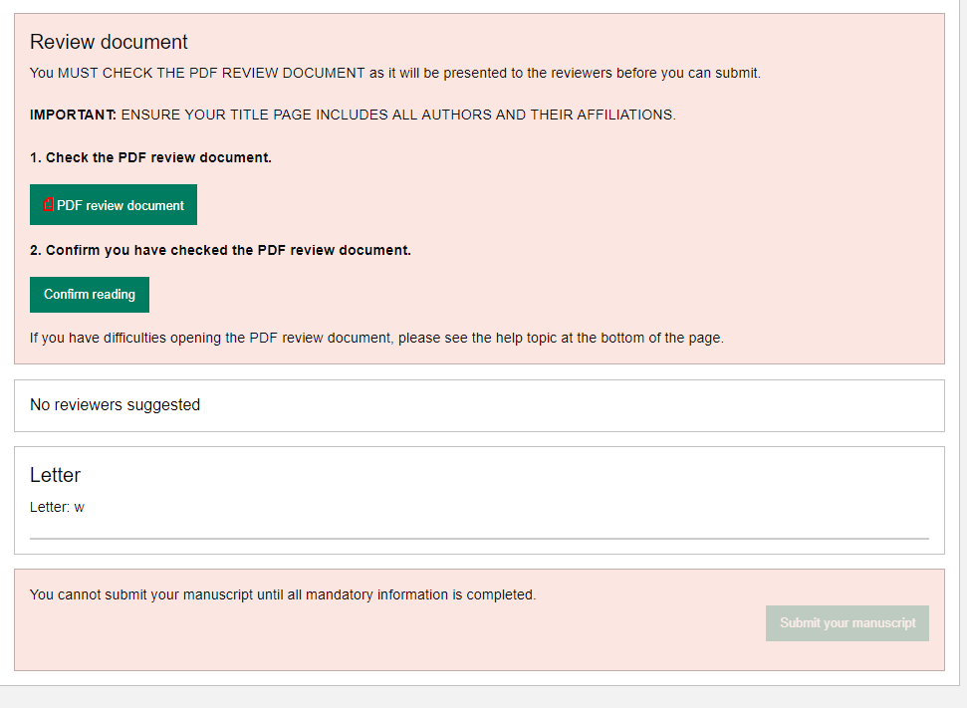

Send – Submit your manuscript
Review the submission information
The author will be alerted if any information is missing
In case you have problems submitting your manuscript, please contact the Editorial Office directly
Click on “PDF review document” and check if everything is correct
Click on “Confirm reading”
Click on “Submit your manuscript”
1
1
2
2
3
3

